Slide 1
Xamarin UITest for Mobile Automation
William.Jiang@smsmt.com
28/11/2016 @Brisbane-Software-Testers-Meetup

Slide 2
Content
Xamarin.UITest Overview
Prerequisites & Environment Setup
Test Project Structure
UI Test Development Procedure
Running UI Tests
Trouble-shooting

Slide 3
Xamarin.UITest Overview – 1
With a C#-shared codebase, developers can use Xamarin tools to write native Android, iOS and Windows apps with native User Interfaces and share code across multiple platforms.
Xamarin.Forms is a new library that enables you to build native UIs for iOS, Android and Windows Phone from a single, shared C# codebase. It provides more than 40 cross-platform controls and layouts which are mapped to native controls at runtime, which means that your user interfaces are fully native.
Xamarin.UITest is a testing framework that enables Automated UI Acceptance Tests written in NUnit to be run against iOS and Android applications.
Typically, each UITest is written as a method that is referred to as a test. The class which contains the test is known as a test fixture.
Two ways to run Xamarin.UITests:
Upload the tests to Xamarin Test Cloud where the tests are run on pre-selected devices.
Run the tests locally against a device, emulator (Android), or simulator (iOS) by using the Test Runner in Xamarin Studio (iOS or Android) or Visual Studio (Android only).

Slide 4
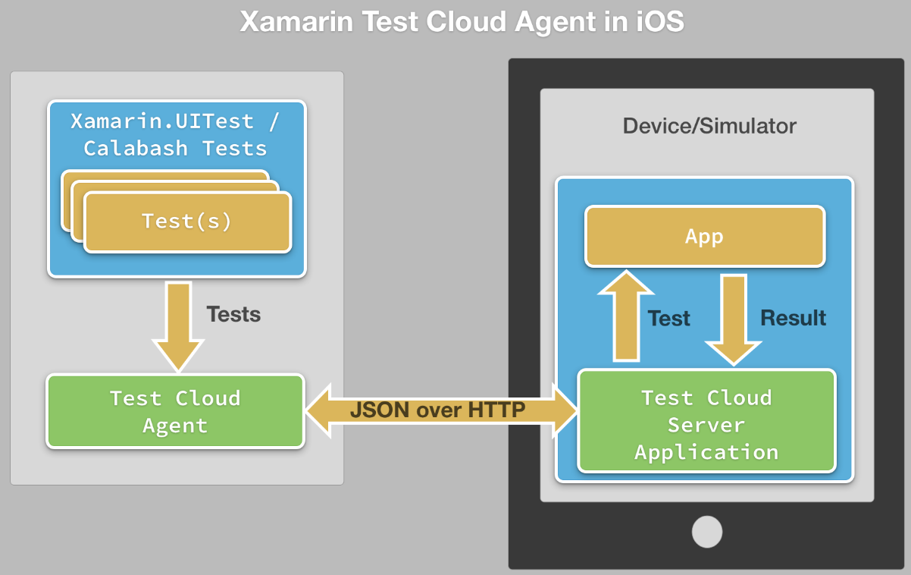
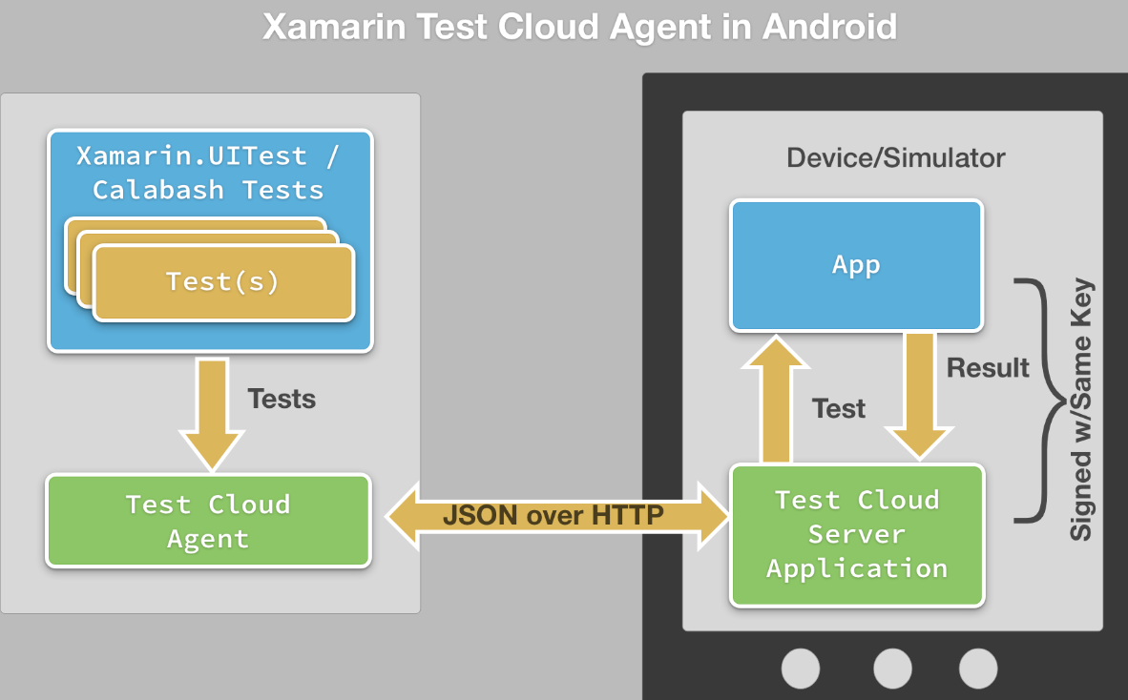
Xamarin.UITest Overivew –2
Xamarin.UITest relies on the Xamarin Test Cloud Agent, a special HTTP server that will communicate with the mobile application being tested.
For Android App: the Xamarin Test Cloud Agent is a separate application that is installed alongside the application to be tested.
For iOS App: The Xamarin Test Cloud Agent must be embedded in iOS applications when the application is compiled.
It should only be included in Debug builds of the application

Slide 5
Prerequisites & Environment Setup
Xamarin.UITest may only run local iOS tests using Xamarin Studio on Mac OS X. In another words, Xamarin Studio on Mac OS X is the only option to run UITest on both Android and iOS devices/simulators.
The demo project, Phoneword.UITest, is build with Xamarin.Forms sample project – Phoneword (https://developer.xamarin.com/samples/xamarin-forms/Phoneword/) to test its Android & iPhone apps.
By itself, Phoneword.UITest is a class library project referring NUnit 2.6.4 and SpecFlow.NUnit 1.1.1, DO NOT Change/Upgrade them!
To test Android app, the devices connected shall enable "USB Debugging" by checking Settings -> Developr options -> USB Debugging.
To run UI test on Android Emulator, targeted emulators must be launched in advance.
The iOS app shall include codes in AppDelegate.FinishedLaunching method:
#if ENABLE_TEST_CLOUD
Xamarin.Calabash.Start();
#endif
For iOS devices, Settings -> Developer -> "Enable UI Automation" must be enabled.
To run test on physical iOS devices, you need to have an active certificate & iOS Providioning Profile (Development) by following instructions of https://developer.xamarin.com/guides/ios/getting_started/installation/device_provisioning/
Running tests on local physical iPhone, the test app need to be installed in advance.

Slide 6
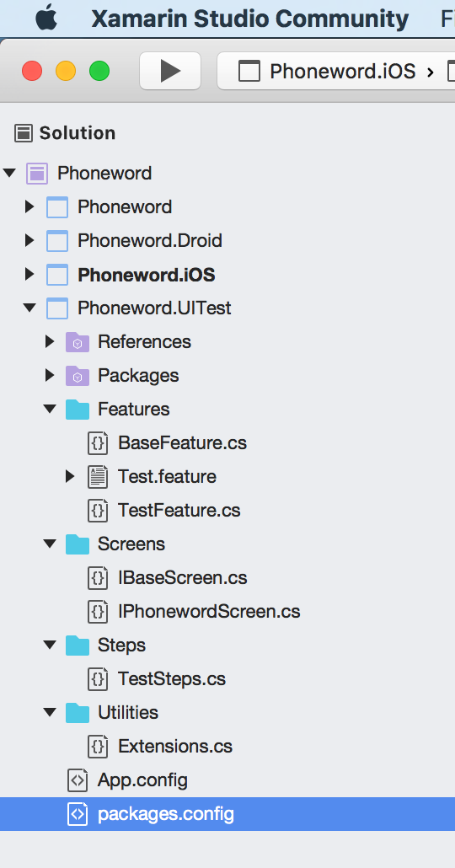
Project Structure - 1
Features: Features and BaseFeature that defines SpecFlow Hooks and shared variables & functions.
Screens: Interfaces defining Func<AppQuery, AppQuery> variables needed by Xamarin.UITest to locate UI elements to simulate user inter-activities.
Steps: The TestSteps.cs, as sample, contains not only the step implementation of the SpecFlow Features.
Extensions.cs in Utilities: helper methods like:
String extention methods to String class to facilitate operations on strings.
Environment (OS & Any connected Android/iOS devices) detecting functions.
StartApp() to deploy and run tests on any remote or local devices.

Slide 7
Project Structure - 2
FeatureContext.Current is used to keep test fixture related environment variables with Set<Type>(instance) or Get<Type>()
Class constructor of Extensions.cs would detect all connected Android/iOS devices locally by running “adb” and “xcrun” commands; and BeforeFeature() defined in BaseFeature.cs would trigger its running before start application under test
It is possible to change these apps running on Android platform or iOS Simulators by modifying the compiled Phoneword.UITest.config (from App.config) to change the loaded assembly
Customised partial classes like TestFeature.cs shall inherit FeatureBase, defining test methods without attribute of [TestFixture].
Extended classes like Android_TestFeature : TestFeature shall specify device details with attribute of [TestFixture] and [Category]s.

Slide 8
UI Test Development Procedure - 1
Defines interfaces of the activities/fragments/views to abstract the UI layout of Android/iOS applications under test.
Implements these interfaces as solid classes.
Preferably, both Andorid and iOS applications use the same identifiers to define the UI layouts ('id' for Android, 'AccessibilityIdentifier' for iOS).
For Xamarin.Forms, AutomationId is not working!
To cope with the differences between Android and iOS applications, extended classes with overriden getters could be helpful.
Some Dynamic Injection means could then be used to load the correct class to the common interface based on application platform (iOS or Android).
BaseScreen could be used as common base class to share common functions/variables like the signuature of PhonewordScreen:
public class PhonewordScreen : BaseScreen, IPhonewordScreen

Slide 9
UI Test Development Procedure - 2
SpecFlow Features shall then be defined to outline the test execution context, test cases, general steps and etc.
'FeatureBase.cs' could be used as base class of all feature definitions to get common methods, variables and test fixture definitions.
[TestFixture] of NUnit 2 is used to decorate the Feature classes that would be instantiated as a set of tests on specific Android/iOS devices with different arguments. FeatureBase class defines multiple constructors that would be used by the NUnit2 test runner to construct test fixtures.
Calling StartApp() in BaseFeature is the most critical step to launch the test app, which would use different service logic defined in Extensions.cs to get the right device and app to run tests.
To support NUnit-Console command with arguments to specify test fixtures by their fully qualified names, the above features could be extended to classes like "iOS91_TestFeature" that has constructors without parameters. Decorated with "TestFixtureAttribute" and "CategoryAttribute", these extended classes/fixtures would specify a full set of Xamarin UI Automation tests on specific devices/simulators/emulators.
Steps shall then be generated as normal SpecFlow test development.

Slide 10
Running UI Tests Locally from GUI
Refer to: Running Tests in the IDE
Both the APP and the DEVICE running tests are determined on the GUI
For Android Device/Emulator: Android project is selected as Startup project
Device connected with USB, Unblock the screen, Settings-DeveloperOptions-USB Debugging (Optionally, Stay Awake) checked
Emulator must be started (Otherwise, ‘adb’ cannot find it)
Chose Configuration to any, but “Release|iPhone” is preferred to be used when running in Cloud, then choose the target device/emulator
For iOS Device:
iOS project is selected as the Startup project
Connected with USB, Settings -> Developer -> "Enable UI Automation“ selected
Configuration choose “Debug|iPhone” then choose the target device
For iOS Simulator:
Configuration choose “Debug|iPhoneSimulator” then choose the target simulator
Xamarin UI Test project refers the iOS/Android project under test by adding them to “Test Apps”

Slide 11
Running UI Tests in Cloud from GUI
Refer to: Submit UITests to Xamarin Test Cloud
Log in to Xamarin Test Cloud (testcloud.xamarin.com) with Safari browser and create a test run, one for iOS and one for Android.
The UI Tests could be run locally with steps of previous page
Choose right Configuration: “Release” for Android, “Debug|iPhone” for iOS
From “Unit Tests” pad, right click the device agnostic test fixture (Such as Android_LoginFeature or iPhone_LoginFeature) and “Run in Test Cloud”
Choose the application to test, then “Upload and Run”
Notice the first line output of the “Test Cloud” window with useful info
Once the asynchronous upload is done, Safari would be launched to prompt choosing devices in Cloud. Then click “Select x devices”, “Done”. For iOS: only iPhone and iPod devices are supported.
It seems there is no limit of choosing how many device to run tests for free 30-days trial user.
The Safari would then be redirected to the user panel to see the test progress & result.

Slide 12
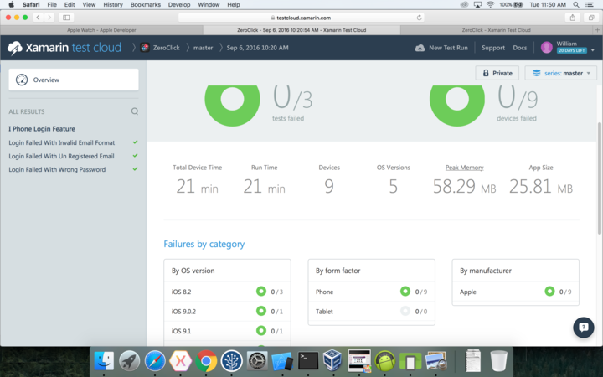
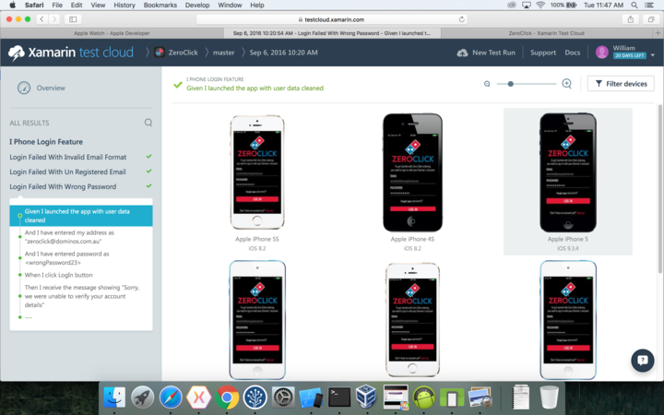
Running UI Tests in Cloud from GUI – Sample Result View

Slide 13
Running Tests in Cloud with command -1
Refer to: Submitting UITests at the Command Line and Cheat Sheet
The test-cloud.exe in packages/Xamarin.UITest./tools is used as below:
$ mono test-cloud.exe submit <YOUR_IPA_OR_APK> <TEST_CLOUD_TEAM_API_KEY> --devices=<DEVICE_ID> --assembly-dir=<PATH_TO_UITEST_ASSEMBLIES> --user=<USER_EMAIL>
Output from “Test Cloud” window of previous page would be useful to get pathes of mono, test-cloud.exe, IPA or APK
For other parameters, login into Xamarin Test Cloud -> “New Test Run” -> Choose iOS/Android App -> Select devices -> Next, get snippet like: mono packages/Xamarin.UITest.[version]/tools/test-cloud.exe submit yourAppFile.ipa 4f000101bb05951d724c04f25c414933 --devices 8315dc76 --series "master" --locale "en_US" --app-name ”Phoneword" --user yourEmail@Address --assembly-dir pathToTestDllFolder
Composing solid commands with the above three input with extra options to specify test fixtures
Login into Xamarin Test Cloud to monitor the progress and see the test results.

Slide 14
Running Tests in Cloud with command -2
Sample command to run iOS tests on Xamarin Cloud:
/Path_to_mono/mono "/Path_xxx/test-cloud.exe" submit "Fully_quallified_IPA_file_path" 4f000101bb05951d724c04f25c414933 --devices efd3b6f1 --series "master" --locale "en_US" --app-name "YouAppName" --user YourEmail@Address --fixture Phoneword.UITest.Features.iPhone_TestFeature
Sample command to run Android test on Xamarin Cloud:
/Path_to_mono/mono "/Path_xxx/test-cloud.exe" submit "Fully_qualified APK_filename" 4f000101bb05951d724c04f25c414933 --devices e637bf62 --series "master" --locale "en_US" --app-name ”Phoneword" --user YourEmail@Address --include "Android" --exclude "Local"

Slide 15
Running Tests Locally with Command
Refer to: Categorizing Tests and NUnit-Console command with options
UI Test project would be compiled as Nunit2 test assembly, thus could be run with NUnit-Console command with options:
nunit-console path/to/TestAssembly.dll
Physical devices must have been unlocked as required to run from GUI
Sample commands are listed below:
Run tests on all connected Android/iOS devices/emulators: nunit-console bin/Debug/Phoneword.UITest.dll -include Local
Run tests on all connected Android devices/emulators: nunit-console bin/Debug/Phoneword.UITest.dll -include Local+Android
Run tests on all connected iOS devices and targeted iOS simulators: nunit-console bin/Debug/Phoneword.UITest.dll -include Local+iPhone
Notice for iOS tests on physical device, the app of Debug must have been installed

Slide 16
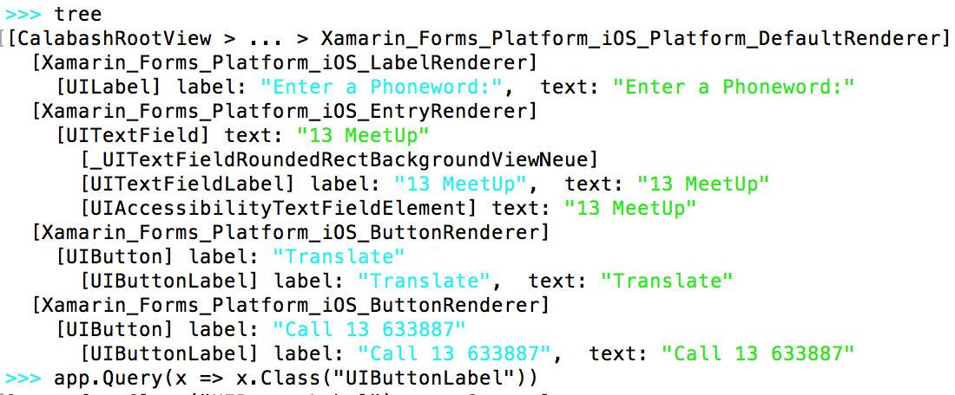
Trouble-shooting
Failing to update resource files after pulling source codes:
”git reset –hard” + “git clean –f –x –d”
Working with NUnit2.6.4
Modify packages.config directly
Remove downloaded Nuget packages manually then refresh
For iOS, UITest works with Debug mode with Calabash started
Beware of the inconsistence between platforms
Query manually from Immediate window
Encapsulate cross-platform controls like Button.text
Example if there is enough time

Slide 17
Demo
Any questions

